Slide 1

LASAGNE digitaL frAmework for SmArt Grid and reNewable Energies WP3: Coordination model and intelligent digital twins
ERA-NET 108767
SFOE 810008657
Giovanna Di Marzo Serugendo
Philippe Glass

Slide 2

Milestone M2
Monthly meeting January 17, 2323
M2:
Coordination model, digital twins and design of distributed collaborative ML methods are
implemented on an experimental edge-to-cloud architecture.
Outcomes from WP2 are not yet supported

Slide 3
Milestone M2 : state of progress
Monthly meeting January 17, 2323
Sub-section |  | State of progress
Coordination model |  | defined and implemented
Digital twins producer, consumer, learning agent, regulator a series of algorithms and scenarios for establishing contracts |  | defined and implemented
Design of distributed collaborative ML methods | KTH work
 | UNIGE work: Decentralised Federated Learning through coordination platform | definition ongoing
Implemented on an experimental edge-to-cloud architecture (edge-to-edge?) Real-life scenarios: using real data from “Les Vergers” Living Lab |  | implemented and evaluated
Technical report |  | not started yet

Slide 4
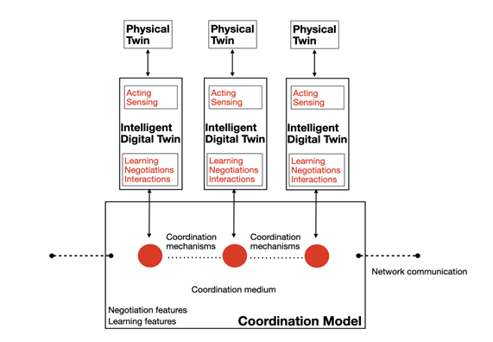
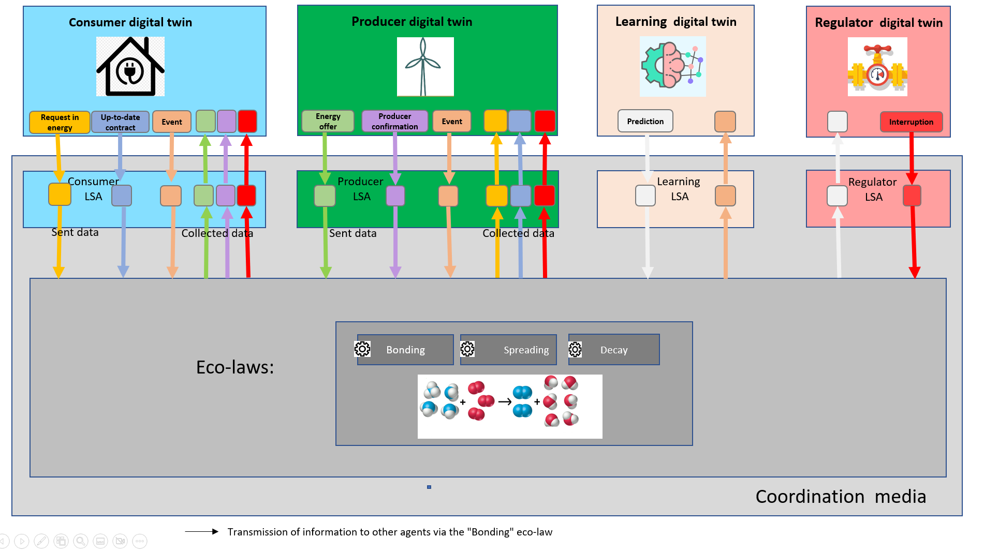
Coordination platform and digital twins
Monthly meeting January 17, 2323
Implementation of a coordination model using digital twins, a shared virtual environment (tuple space) and coordination laws.
Implementation of digital twins : define agents' behaviors as consumer, producer, learning agent and node regulator. Agents act autonomously, adapt, organize and make decisions according to the situation.
Generation of supply contracts between producers and consumers by using self-adaptation.
4

Slide 5
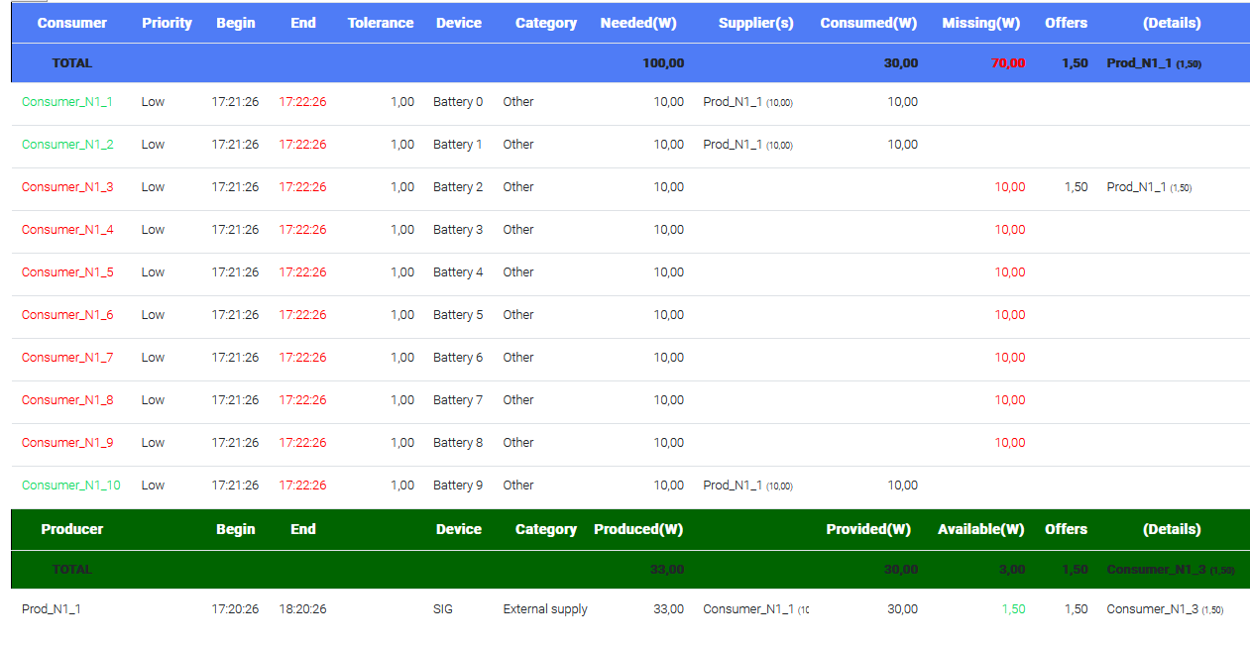
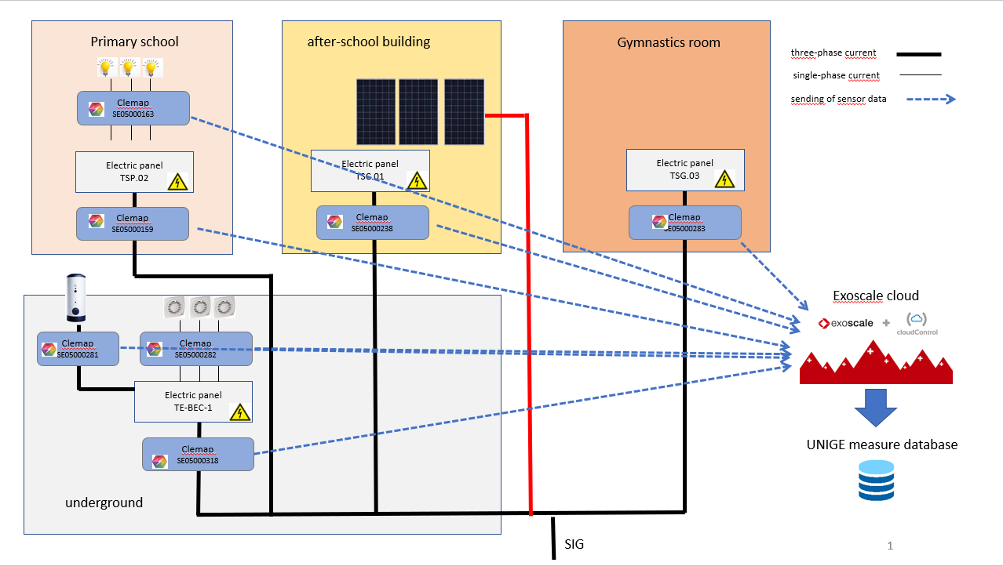
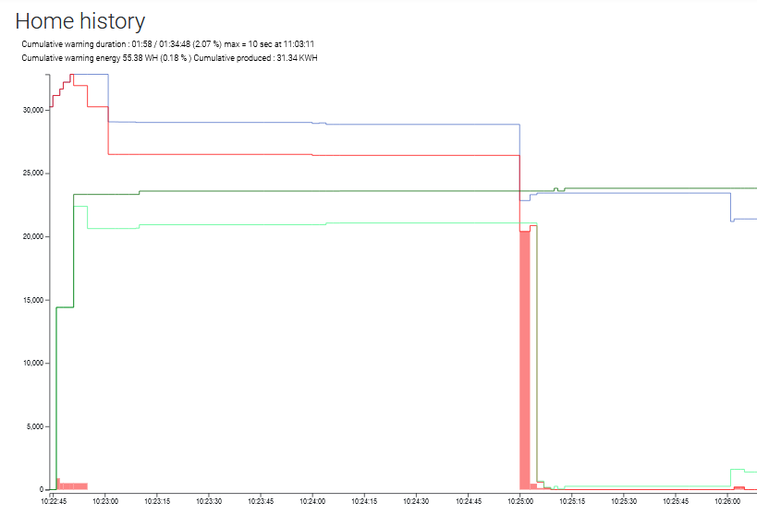
Implementation + experimentation edge-to-cloud
Monthly meeting January 17, 2323

Slide 6
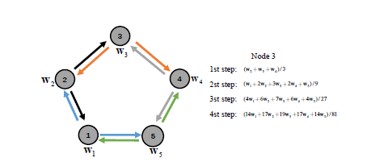
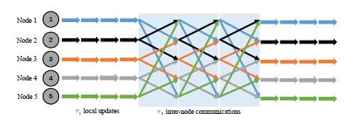
Gossip-Based Decentralised Federated Learning
Monthly meeting January 17, 2323
Coordination platform
Agents → Local Learning agents (any ML technique)
Eco-laws: Aggregation + Spreading → Gossip
Aggregation: appropriate algorithm to combine learning (average or other)
Wei Liu, Li Chen, and Wenyi Zhang : Decentralized Federated Learning: Balancing
Communication and Computing Costs

Slide 7
Gossip-Based Decentralised Federated Learning with coordination platform
Monthly meeting January 17, 2323
Learning agent
Learning agent
Tuples space
Tuples space
LSA
LSA
LSAext
LSAext
Eco-Laws
Eco-Laws
Bonding
T
Bonding
T
T
Spreading
T
Spreading
Decay
Decay
T
T
Aggregation
T
Aggregation
T
T
T
Gossip
Gossip
7

